Slide 1
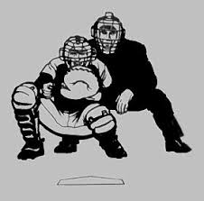
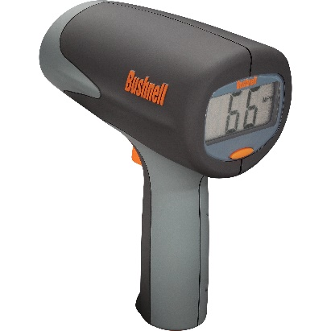
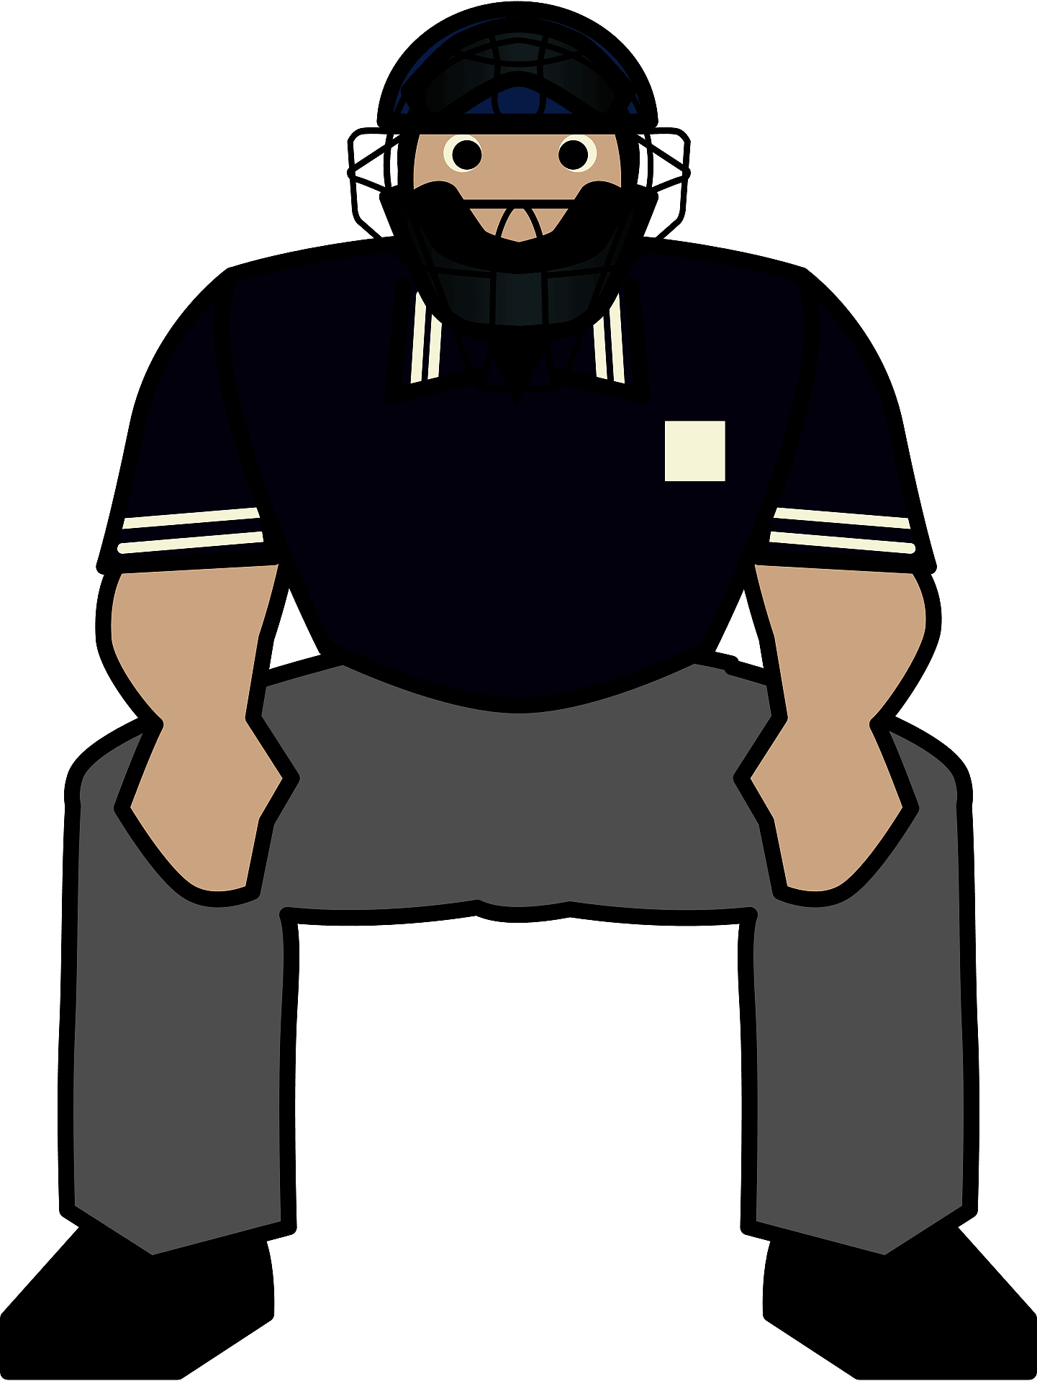
Using Technology to Improve Your Platework
Notes:
This topic is right up my alley.
I’m a mathematician by degree and a Nuclear Training Instructor by trade.
For those who know me well, there will probably be some eye-rolling during parts of this presentation.
For those who don’t know me well, you’ll figure me out pretty quick.

Slide 2
Introduction
The use of video and Trackman pitch tracking software are invaluable resources in helping you as an umpire to gain consistency and confidence calling balls and strikes.
I will show you how to better understand the Trackman reports to maximize their benefit and give some philosophies to keep the information it provides in perspective.
I recognize many of you will not have access to this data, but if you are fortunate enough to work in a park that has full Trackman, you’ll better understand how to use this data.

Slide 3
Trackman
Trackman was developed in 2003 to monitor golf ball flight.
In 2017, Trackman was being used in professional baseball to measure multiple data points of the baseball.
A Trackman report contains 75 Columns of data of which approximately 40 are numerical data points.
Of the 75 columns in the Trackman report, there are only three columns that you should care about.
Where possible, review the data in Trackman in conjunction with watching a video of the game.

Slide 4
Trackman Data
The three columns that will benefit you the most are Pitch Call, Plate Height Location (PlateLocHeight), and Plate Side Location (PlateLocSide).
Notes:
This clip only shows only about ¼ of the columns on the report.

Slide 5
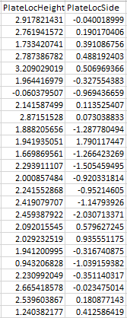
Trackman
Plate Location Side values are the distance from the center of home plate, in feet, for the center of the baseball as it crosses the front edge of home plate.
Positive number are to the right side of the plate (inside to a right handed batter)
Negative number are to the left side of the plate (outside to a right handed batter)
Plate Location Height values are the height of the ball as it crosses the front edge of home plate
So how do these values translate to balls and strike at home plate?

Slide 6
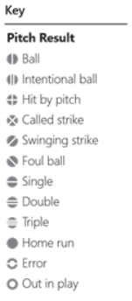
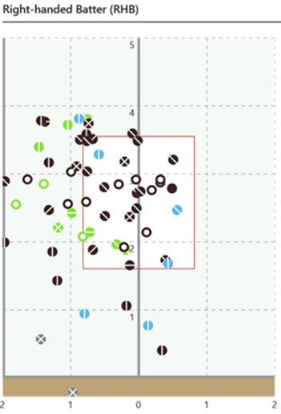
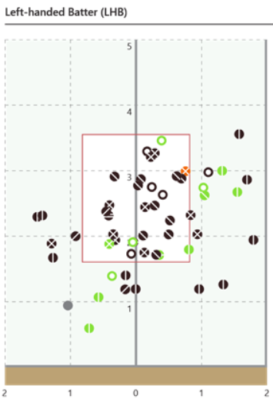
Negative values
Positive values
Negative values
Positive values
Each 0.1 horizontal is ≈1 inch
Notes:
Review Trackman report including Pitching Result Key and highlighted pitches.
Trackman will usually have a different report for each pitcher.
When you look at Trackman plot along with a game video, you’ll be able to see where each individual pitch is on the plot.
1.&2.&3. High outside miss and low pitch miss and inside corner to LH batter
4. Outside corner
5. Low outside -- tell story about attempted bunt and bad data on pitch call

Slide 7
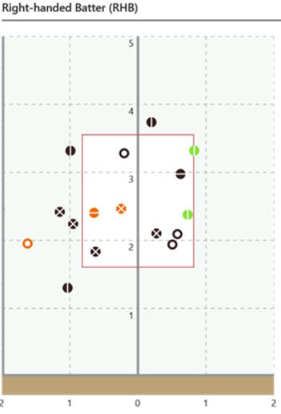
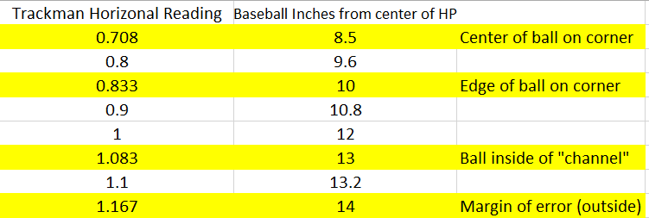
Philosophical
Negative values
Positive values
Notes:
This is PERRY RAMICONE’s philosophy! It is neither right or wrong. Don’t think this is gospel and what you should call for the strike zone.
Later on, DB is going to talk his expectations for the SAC and Conference Carolina baseball.

Slide 8
Negative values
Positive values
Negative values
Positive values
Each 0.1 horizontal is ≈1 inch
Notes:
The solid blue line is showing the edge of the strike zone for a pitch in the “channel”.
The dashed blue line shows the “Perry Ramicone” margin of error that he can live with.
The Trackman version I am showing does not tabulate correct, missed, or borderline pitches. The next will show a pitch analysis that counts and calculates these values.

Slide 9
Dave Brown SEC Pitch Analysis
Notes:
This is the pitch analysis give to DB from the SEC conference office/coordinator.
It appears to be from Trackman as the horizontal and vertical coordinates appear to be identical.
A report that identifies the number and percentage of correct, missed, and borderline pitches is supplied. This can be very useful.

Slide 10
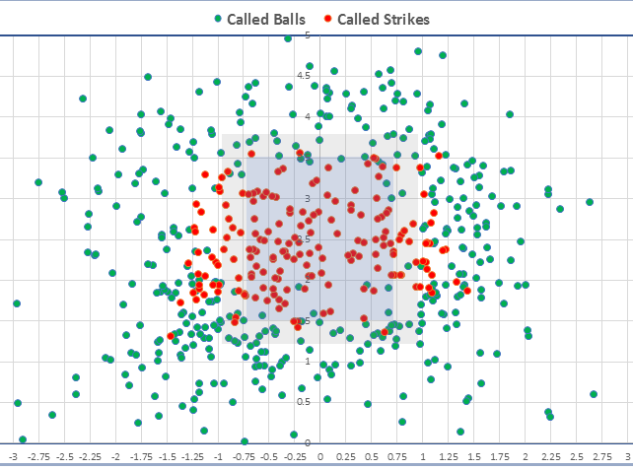
Notes:
For this program, they are calling the edge of the “borderline” strike zone at about ±0.97 which is about 1.5 inches off the plate. Solid and dashed lines were added by me for clarity.
This plot also does not show if pitches were for a RH or LH batter or from RH or LH pitcher. This would have to be gleaned from the raw data.
By not seeing video, we don’t know if some of these “called ball” pitches in zone or on border were butchered by the catcher or if some of the “called strike” pitches were “Confidence strikes” for a struggling pitcher.
Give DB some time to discuss Paul Guillie’s expectations for accuracy and then Dave’s expectations for accuracy in the SAC/CC.

Slide 11
Trackman Thoughts
Don’t get caught up with getting every pitch perfect. If we were that good, our season would run from April until September.
Don’t necessarily call the Trackman strike zone. You may not go as high and may expand the corners.
Use Trackman as a tool – Look for trends. Do I go farther on the outside corner for LH batters than RH batters? Are you missing the low pitch
Recognize you’re going to miss more pitches in a game where 350 pitches are thrown than when 250 pitches are thrown.
Try to analyze Trackman charts while watching video – Did the catcher butcher the pitch? Are you missing pitches on check swings?
Remember that the box show on the pitch display doesn’t adjust for the height of batter and that the top and bottom of the strike zone is determined as the batter is prepared to swing at the pitch, not when they are standing straight up.
Notes:
Tell Ned Timmerman story.

Slide 12
Video From CF Camera
Even if you are not able to get Trackman data, video from the CF camera is next best thing if the game is being shown on television or closed circuit.
Some things to keep in mind watching video from CF camera:
Many times, it will difficult to see home plate to gauge inside and outside pitches.
The camera will make the baseball look farther outside on RH batter and farther inside on LH batter.
Video will show catchers with excessive glove movement and butchering pitches.
If you are not able to see the corners of the plate from the camera, you can put a piece of tape on the monitor to indicate the corners or stretch a piece of string or a rubber band around your monitor to see if you are going too far inside, outside, up, or down on pitches.
Notes:
Tell personal story about inside curve balls.

Slide 13
Video From CF Camera
In addition to watching pitches, you can also monitor your plate mechanics during the game:
How is my head height?
Find a reference point on the backstop. Is the top of my head in the same place in the 8th inning as it is in the 1st inning
How is my slot position – If you are hidden by a RH batter, you may be too far in the slot
Am I moving my head excessively
How does my strike call/strike three call look
Did the batter intentionally move into a pitch
Notes:
Tell story about inside curve balls.

Slide 14
Video From Behind Home Plate
Limited on what you can learn about your plate work
Slot setup
Head movement
Strike mechanics
What did you call the pitch relative to the catcher’s glove

Slide 15
Partner (non-technology)
Use your partner as a resource for your mechanics or strike zone.
If a partner asks about a pitch or his strike zone, don’t tell them what you think they want to hear.
Conversely, if you ask a partner about a pitch or your strike zone, don’t get upset if the response is not flattering – “Don’t ask the question if you don’t want to hear the answer.”
Notes:
Tell about Paul Taylor story

Slide 16
Questions?

Slide 17
The End
Have a great season and call lots of strikes!

