Slide 1
South Atlantic Conference and Conference Carolinas Staff Meeting

Slide 2
Staff Introductions

Slide 3
Rules Presentation

Slide 4
Conference Carolinas
Assigning system/Arbiter
Two-man Crews
Conference Pay/Hotels
3 Game Series -525.00
Preseason and Mid-Week DH-365.00
Preseason and Mid-Week Single- 195.00
JV Single-150.00
JV DH-250.00
Non-Conference Pay
Tournament/8

Slide 5
South Atlantic Conference
Assigning system/Ref Quest
Three-man Crews
Conference Pay/Hotels
3 Game Series -475.00
Preseason and Mid-Week DH-305.00
Preseason and Mid-Week Single- 190.00
JV Single-150.00
JV DH-250.00
Non-Conference Pay
Tournament/18

Slide 6
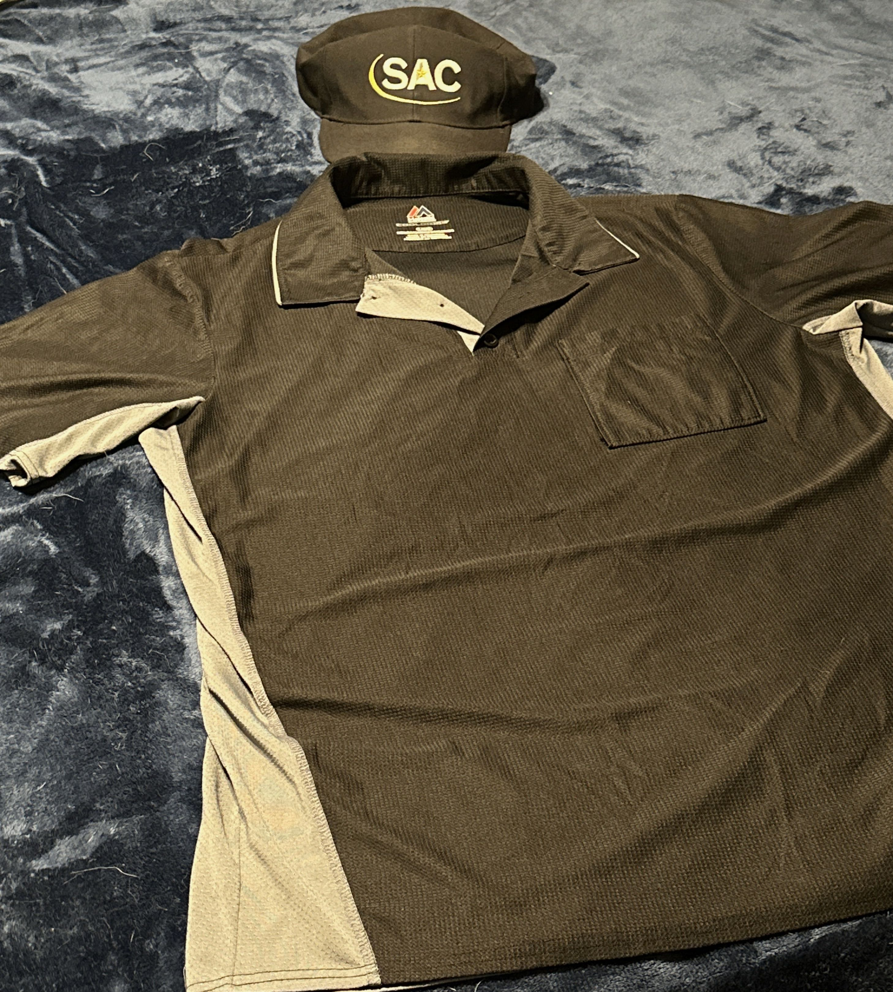
Uniforms for Umpires
Andy Glenn
Phone number 865-924-6398
Hat and Shirt Needed is below

Slide 7
All Schools in SAC and Conference Carolinas
Red dot is Conference Carolinas
Blue dots are SAC schools

Slide 8
Website
http://psaaos.com/

